Slide 1
‘ ’
horntell
Unpluggd 2014
Notes:
Hey Hiee..
So, here

Slide 2

Trip sponsored by
Notes:
Before we get into the launch, I would like to thank someone, without whom we wouldn’t be standing here today. We didn’t have enough money for this launch trip, but awesome people at RapidMoon (one of our early users) realized the potential of Horntell launching at Unpluggd and sponsored the trip. RapidMoon is the easiest way to build user-interfaces in browser. Very cool product, they have. Definitely, check them out.
Let’s move into the launch then.

Slide 3





story
story
Once Upon A Time…

Slide 4
solution
solution
Bulk Marketing Is Dead
Building champions mean:
Coming forward as if you care for them
Stop spamming
Stop selling to them 24x7
Start talking (like a friend) ♥
Making them trust you
Market them things only which they care about and at the moment they want it

Slide 5
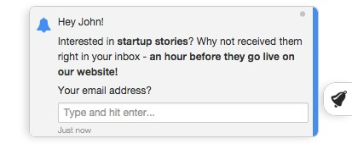
horntell
horntell
Engaging Users Like A Boss
Horntell tracks behavior of each user in your app and then allows you to target them precisely the way you want to.
Turn your bulk campaigns into behavior driven campaigns.
Mobile-first and web-ready
Big Data analytics engine
Real Time targeting

Slide 6
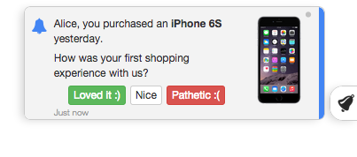
horntell
horntell
Bulk Out, Targeted In
Whenever someone buys something for the first time? Done.
Every male user in US who hasn’t ordered anything? Done.
Everyone who have answered more than 3 times in the forum? Done.
Everyone who signed up 7 days ago? Done.

Slide 7
market
market
Mobile + Web
$100bn
2017
Big-Ass Market
http://www.information-age.com/technology/cloud-and-virtualisation/2095578/saas-will-be-$145bn-market-this-year---gartner
http://www.portioresearch.com/en/major-reports/current-portfolio/mobile-applications-futures-2013-2017.aspx

Slide 8
competition
competition
Name | What they do? | Country | How are they doing? | How are we better?
Intercom.io | Messaging platform for web and mobile | US | 2000 customers Raised $30mn | Real-time targeting Multiple formats of notifications Triggers (absolute necessity for notification platform)
Customer.io | Email automation platform | US | 400 customers Raised $400k | They are limited to just emails Real-time targeting
Mixpanel | Earlier analytics, just now came into engagement | US | Raised $12mn | They engage just the mobile users, not web Real-time targeting
WebEngage | Web engagement platform | India | 22,000 users Raised undisclosed amount | We track behavior over whole lifecycle of user Advanced and real-time targeting We do Mobile

Slide 9
fund
fund
$325k for 12-months Runway
Description | Cost per month | Cost in 12 months | Notes
Office | Rs 70,000 | Rs 8,40,000
Team 6 engineers, 2 marketing, 2 designers, 1 admin/accounts | Rs 5,50,000 | Rs 66,00,000 | Averaged at Rs 50,000 per person per month
Technology Infrastructure | Rs 2,50,000 | Rs 30,00,000
Office Overheads | Rs 30,000 | Rs 3,60,000
Marketing | Rs 5,00,000 | Rs 60,00,000 | Ads, PR, Content Marketing
Misc | - | Rs 10,00,000 | Food, Customer Delights, Travel
TOTAL |  | Rs 1,78,00,000 | $325k (Rs 2,00,00,000)

Slide 10
runway
runway
1000 Users Paying $150 each
Time Frame | Product Goal | Customer Goal | Notes
2014 Q4 | Improved tracking and targeting | 3 paying customers | Very early users
2014 Q4 – 2015 Q1 | Better integration in mobile games | 100 paying customers
2015 Q2 | Better analytics and insights engine | 300 paying customers | Better game integration in previous quarter will give a huge untapped niche to cater to
2015 Q3 | Launch of platform API + 3rd party integrations | 700 paying customers
2015 Q4 | Linked Accounts to let end-user manage his own notifications from various sources | 1200 paying customers | Platform API in previous quarter will open up doors for people to develop over our platform

Slide 11
thank you
thank you
HELLO@horntell.com
$325k will get us to $150k MRR in 12 months

